Slide 1

Attrition Report

Slide 2
KPIS
Employee Count: 4,410
Attrition Count: 711
Average Age: 37 Years
Active Employees: 3,699

Slide 3
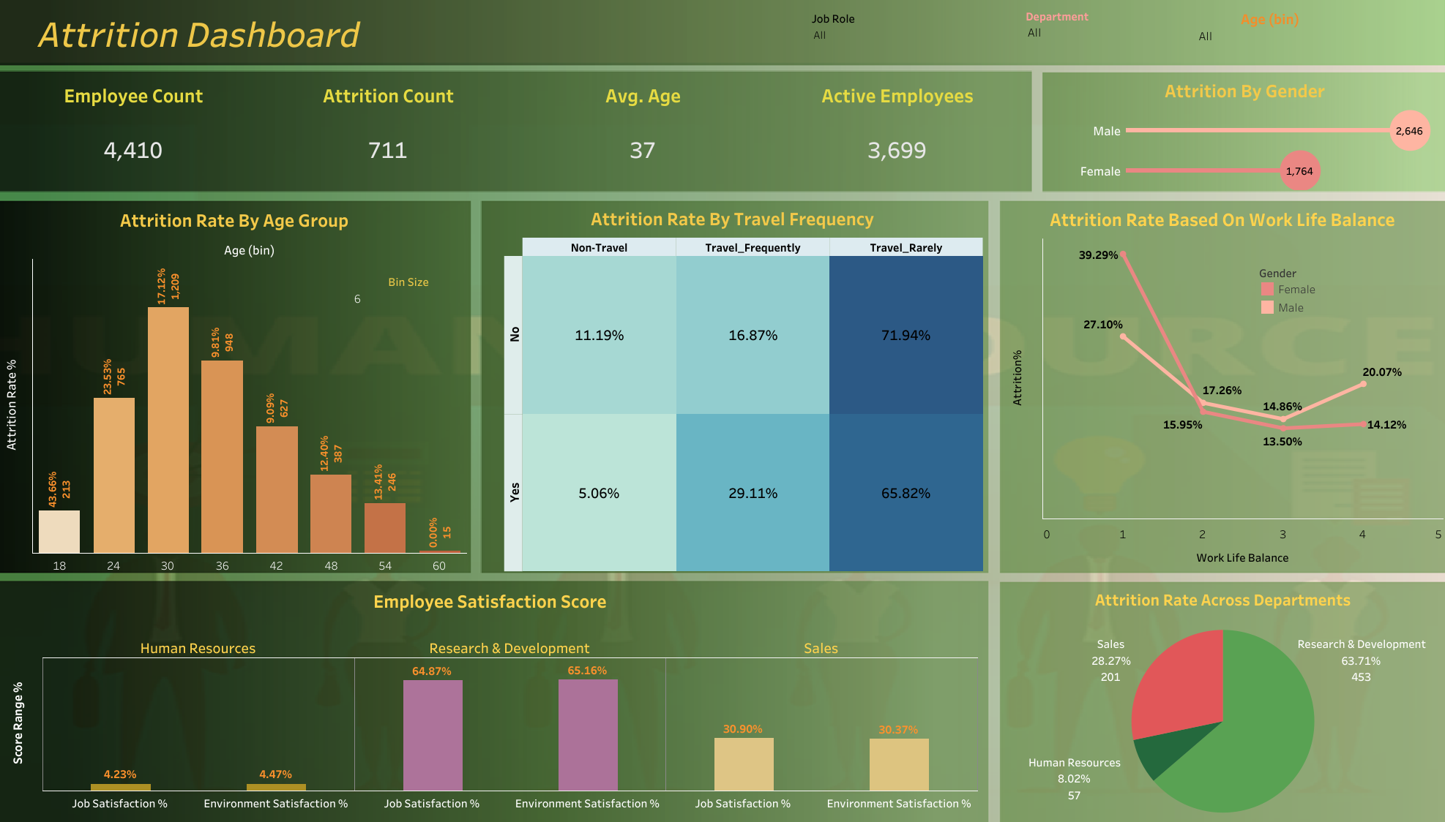

Slide 4
Attrition Dashboard Analysis
Attrition by Age Group:
The highest attrition rate (25.53%) occurs in the 24-30 age group, with a significant drop as age increases. The lowest attrition is in the 54-60 age group (0.00%).
Attrition by Travel Frequency:
Employees who travel frequently have the highest attrition (29.11%), while those who rarely travel have the lowest (5.06%). Non-traveling employees show moderate attrition rates.
Attrition by Gender:
The data indicates that male employees have a higher attrition rate (2,040) compared to female employees (1,752). This suggests that more males are leaving the organization than females.
Attrition Based on Work-Life Balance:
The highest attrition rate is observed in employees with the worst work-life balance (39.29%). As work-life balance improves, attrition rates generally decrease, except for a slight rise at the highest balance level (20.07%).
Departmental Attrition Rates:
Research & Development experiences the highest attrition rate (63.71%), followed by Sales (28.27%). Human Resources has the lowest attrition rate (8.02%).
Employee Satisfaction Scores:
Research & Development shows high satisfaction in both job (64.87%) and environment (65.16%). In contrast, Human Resources has low satisfaction in job (4.23%) and environment (4.47%). Sales has moderate satisfaction scores, indicating room for improvement.

Slide 5
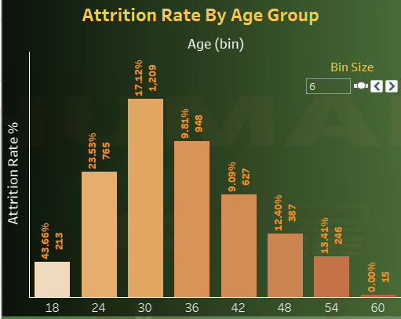
Attrition Rate Insights by Age
High Attrition in Younger Age Groups:
The highest attrition rates are seen in the younger age groups (18-24 and 24-30), suggesting that younger employees are more likely to leave the organization. This could be due to various factors such as career exploration, educational pursuits, or dissatisfaction with entry-level roles.
Stability in Mid-Career Age Groups:
The attrition rates drop significantly in the mid-career age groups (30-36 and 36-42), indicating that employees in these age groups are more settled and satisfied with their roles.
Slight Increase in Attrition in Later Career Stages:
There is a slight increase in attrition in the 42-48 and 48-54 age groups, which could be due to mid-career changes, seeking new challenges, or personal reasons.
Low Attrition in Pre-Retirement Age Group:
The lowest attrition rate is seen in the 54-60 age group, indicating that employees nearing retirement age are more likely to stay with the organization until retirement.

Slide 6
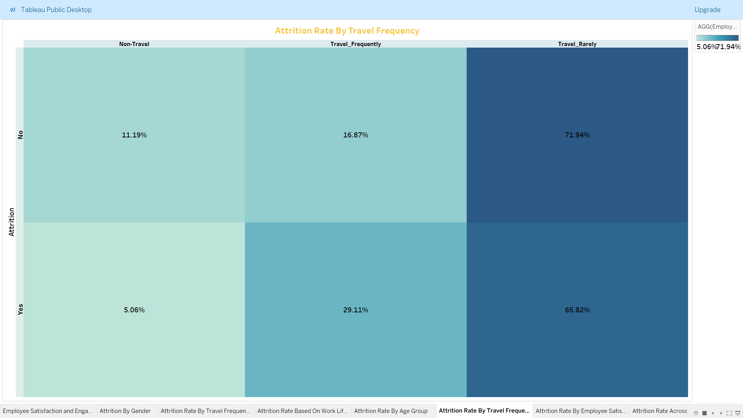
Attrition By Travel Frequency
Non-Travel
Attrition Rate: Employees who do not travel for work tend to have lower attrition rates. This group often enjoys a stable work-life balance and fewer disruptions to their personal lives.
Factors: Stability, consistent work environment, and predictable schedules contribute to lower attrition rates among non-travelers.
Travel Infrequently
Attrition Rate: Employees who travel infrequently have a moderate attrition rate. This group experiences occasional disruptions but generally maintains a balance between work and personal life.
Factors: The occasional travel can provide variety and opportunities for professional growth without causing significant stress or burnout.
Travel Frequently
Attrition Rate: Employees who travel frequently have the highest attrition rates. The demands of frequent travel can lead to stress, burnout, and a negative impact on personal life, contributing to higher turnover.
Factors: High stress levels, fatigue, and the challenge of maintaining a work-life balance are significant contributors to higher attrition rates among frequent travelers.

Slide 7
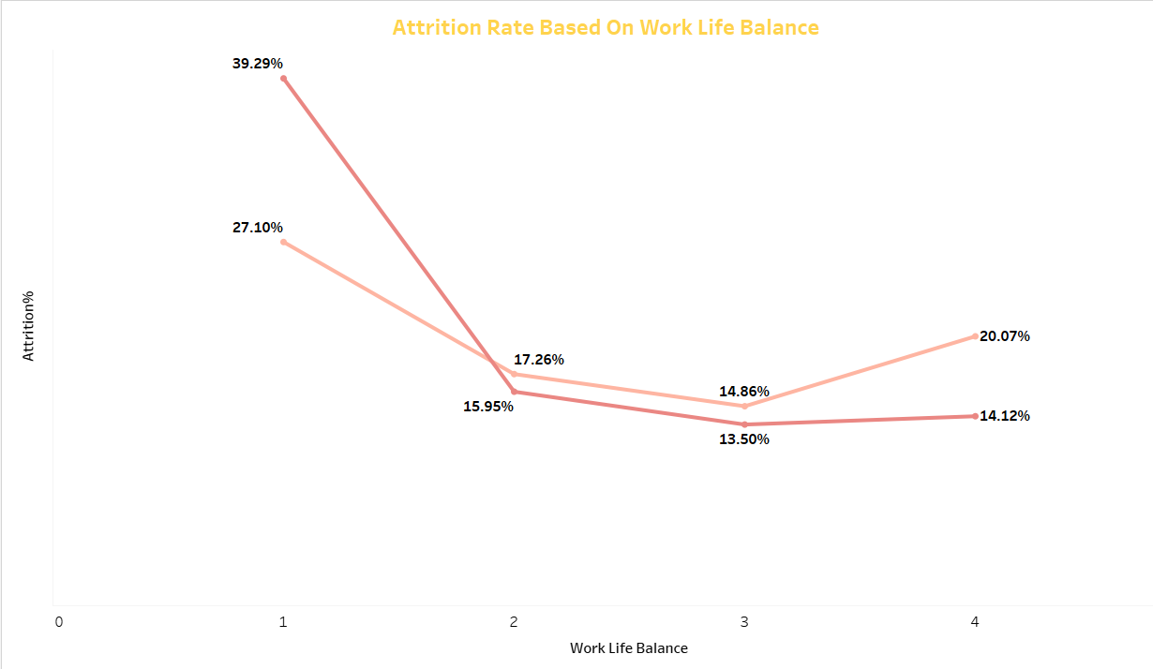
Impact of Work-Life Balance On Attrition
The chart shows a clear inverse relationship between work-life balance and attrition rates.
Employees with the lowest work-life balance (score 1) have the highest attrition rate at 39.29%, while those with better work-life balance (score 3) have the lowest attrition rate at 13.50%.
This suggests that improving work-life balance could significantly reduce employee turnover.
Notably, even moderate improvements in work-life balance (score 2) lead to substantial reductions in attrition.
Prioritizing work-life balance initiatives could be crucial for retention strategies.

Slide 8
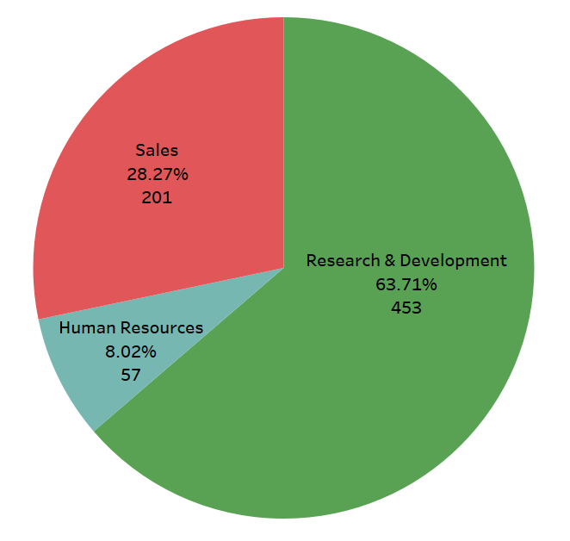
Attrition By Department
The pie chart illustrates the distribution of attrition across different departments.
The Research & Development department accounts for most attrition at 63.71% (453 employees), indicating a significant area of concern.
Sales follows with 28.27% (201 employees), while Human Resources experiences the least attrition at 8.02% (57 employees).
The disproportionate attrition in Research & Development suggests potential issues specific to this department, such as workload, job satisfaction, or career development opportunities.

Slide 9
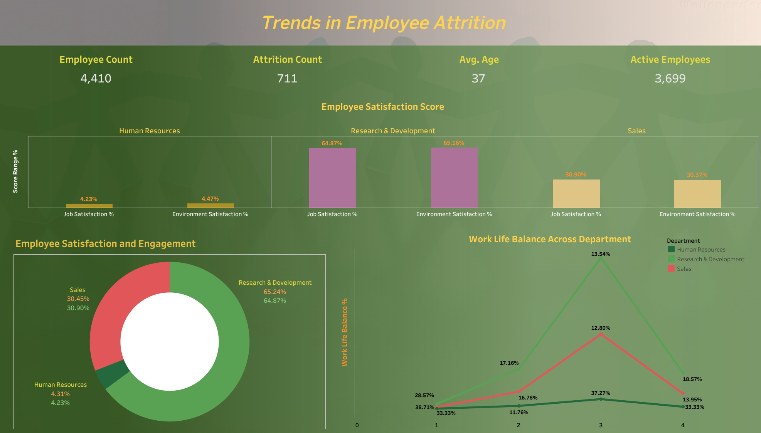

Slide 10
Employee Satisfaction & Engagement: Insights & Trends
Insights:
Human Resources:
The scores are relatively balanced, indicating that employees in HR are almost equally satisfied with their job roles and the work environment. However, the overall satisfaction is lower compared to other departments.
Research & Development:
This department has the highest satisfaction scores, suggesting that employees in R&D are highly content with both their job roles and the work environment. This could be due to engaging projects, innovation opportunities, or supportive management.
Sales:
Sales has the lowest satisfaction scores, indicating potential issues such as high pressure, targets, or a less supportive work environment. This department may need targeted interventions to improve employee morale.
Overall Trends:
Across all departments, Environment Satisfaction scores are slightly higher than Job Satisfaction scores. This suggests that while employees generally find the work environment acceptable, there might be specific aspects of their job roles that need improvement.

Slide 11
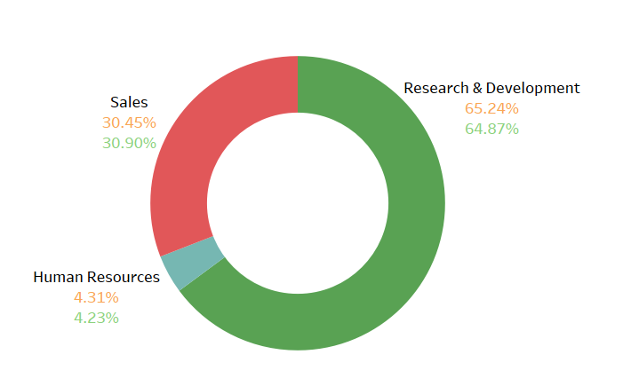
Employee Satisfaction and Engagement
Job Satisfaction
Job Involvement
Job Satisfaction:
Sales (30.45%): This indicates a moderate level of job satisfaction among employees in the Sales department. While not critically low, it suggests there is room for improvement.
Research & Development (64.78%): A high level of job satisfaction is evident here. This suggests that employees in this department feel valued, supported, and engaged with their work.
Human Resources (4.31%): The very low job satisfaction in the HR department is concerning. This could be due to various factors such as high stress, lack of recognition, or insufficient resources. Immediate attention is needed to address these issues.
Job Involvement
Sales (30.90%): Similar to job satisfaction, job involvement in the Sales department is moderate. This indicates that employees are somewhat engaged but there is potential to increase their involvement through better engagement strategies.
Research & Development (65.24%): High job involvement in this department suggests that employees are highly engaged and committed to their work.
Human Resources (4.23%): Very low job involvement in the HR department points to significant disengagement.

Slide 12
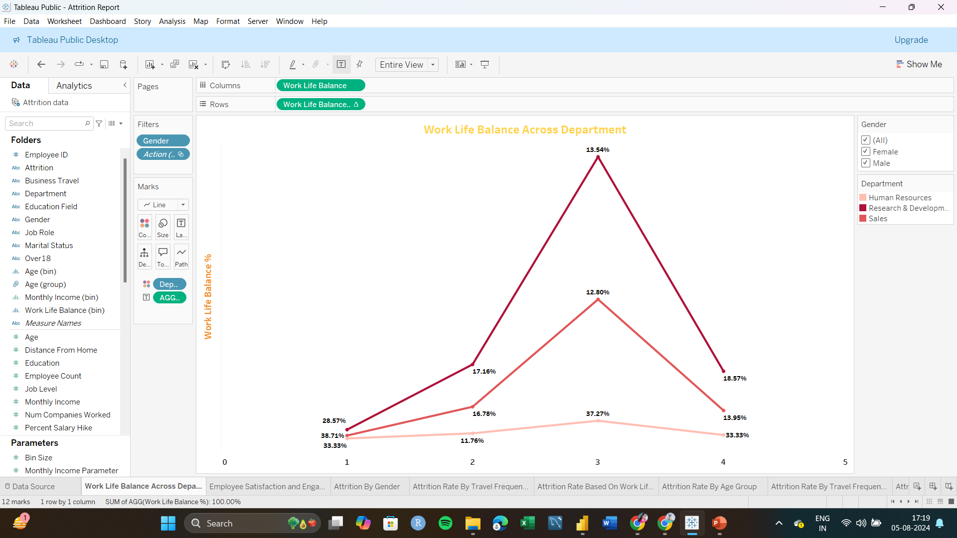
Work Life Balance Across Department​
Human Resources:
Consistently moderate work-life balance percentages, peaking at 17.16% at point 2.
Minimal fluctuations indicate stable work-life balance across the points.
Research & Development:
Highest peak at 33.33% at point 4, showing significant improvement.
Notable peak at point 3 with 13.54%, indicating a strong work-life balance.
Sales:
Peaks at 12.80% at point 3, but overall lower work-life balance percentages.
Steady increase from point 2 (16.78%) to point 4 (33.33%), suggesting gradual improvement.
Department
Human Resources
Research & Development
Sales
Work Life Balance %​
Work Life Balance ​

